Slide 1
Financial Risk Systems with Hazelcast
Ingemar Svensson, CTO SunGard Asset Management Risk & Valuation

Slide 2
What we’ll cover
Introduction
What is Risk?
Overview of our Analytics Grid
Asset and Market Data
Node.js and UX development

Slide 3
How do you calculate Risk?
The uncertainty of the future value of something
Market Data
Price: {$10 as of 01 Dec, $11 as of 02 Dec, $9 as of 03 Dec}
Algorithm
Asset Data
Risk
Ticker: GOOG
VaR: $1.5m
Positions
$10m on GOOG
Challenges:
Difficult for complex asset types
Might need to calculate for thousands or millions positions/assets
Transparency

Slide 4
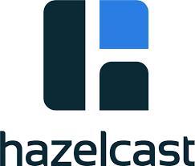
Risk Systems
Real-time, EOD i.e. TimeSeries
Market Data
Grid
Parallel execution
Reports
Audit, versioning i.e. bi-temporality
Analytics
Asset Data
Risk
UI
2nd Level Cache
Positions
Audit, Bi-temporality, OLAP
Other systems
Other systems

Slide 5
Analytics Grid Overview
Distribution of the execution of complex algorithms
Heavy workloads spread across a large number of worker nodes.
Systems submits work in an asynchronous way.
When work is completed, it generates equal or heavier workload in the opposite direction.
Various tools and mechanisms to provide monitoring and instrumentation and protect against overload.

Slide 6

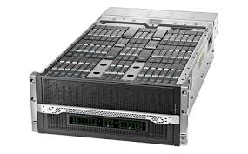

Analytics Grid Overview
callback()
Client API
Request Queue
Response Topic
do(something, callback())
Check quota
Track usage
Throttle
Poll request
Node
Node
Node
Publish response
Quota/Usage/Status
Node
Node
Node
Node
Node
Node
Status
Thousands of cores
£130/core
Significant rack space and power savings
Map/Reduce?
Intel Phi 61 Core Chip for greater density?
Moonshot

Slide 7
Security Master and Market Data Repo
Generic store of all our Market and Asset data.
Heavily used by all our risk systems to retrieve inputs to the analytics logic.
Also used by our end-users for research and trouble-shooting.
Data has various dimensions, time being the most important.

Slide 8
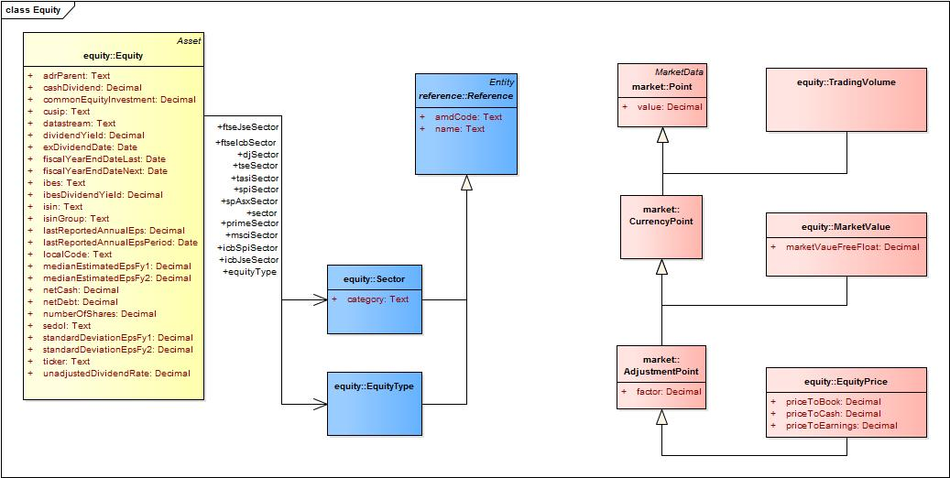


Security Master and Market Data Repo
Model Driven Architecture and Code Generation.
Portable Models
XMI Model
Code Generator (JCodeModel)
Class Factory
Quants, BA’s, Developers

Slide 9
Security Master and Market Data Repo
Time dimension is very important.
A price can be updated daily, every minute, every second etc.
An asset can change by a Corporate Action, manual correction or other lifecycle events such as an expiry.
Price timeseries:
Price_{t1}, Price_{t2}, …. Price_{tn}
asOfTime₀, asOfTime₁, …. asOfTime_{n}
Asset versioning:
Asset_{v1}, Asset_{v2}, …. Asset_{vn}

Slide 10
Node.js
Light-weight technologies to build our product suite on.
Lots of innovation in the JS space.
Tight integration with our UX apps.
var java = require("java");
java.classpath.push("hazelcast-client-3.3.1.jar");
var hazelcastClient = HazelcastClientClass.newHazelcastClientSync(clientConfig);
var map = hazelcastClient.getMapSync("asset");
map.values(new SqlPredicateClass("ticker = ’ADN.L'"), function(error, result) {
console.log(result.toArraySync());
});

